Slide 1
3.01 Apply Controls Associated With Visual Studio Form
Computer Programming I

Slide 2
Essential Standard and Objectives
Essential Standard 3.00 Apply Procedures To Construct Windows Form
3.01 Apply Controls Associated With Visual Studio Form (3%)

Slide 3
Starting Visual Studio
First Time Only:
Choose Default Environment Settings Dialogue Box
Pick the language you are using for the class.
Click on Start Visual Studio.
Microsoft Visual Studio will Load User Settings – Be Patient.
The IDE (Integrated Development Environment) screen will pop up where you create your projects objects and code.

Slide 4
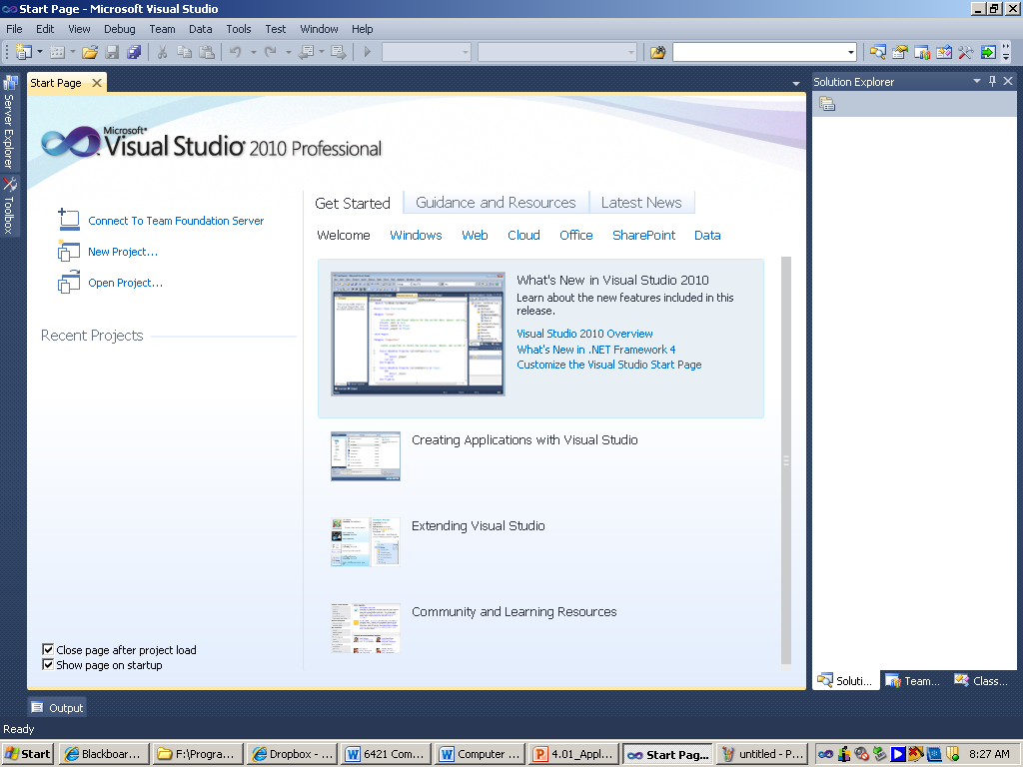
This is the Start Page you will see each time you open Visual Studio.

Slide 5
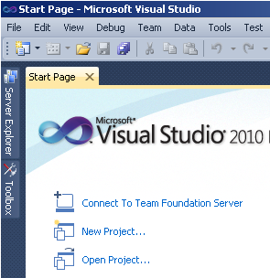
Ways to Create a Project
File > New > Project
Click New Project button
In Recent Projects, Create: Project, click Project

Slide 6
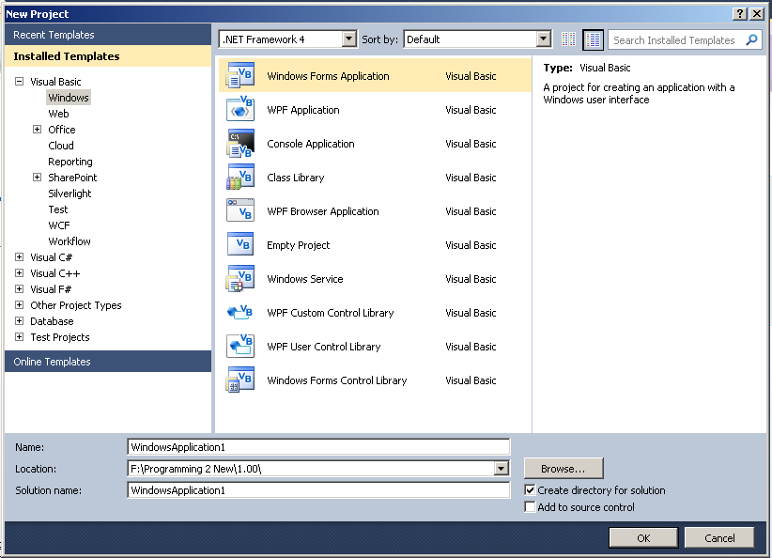
Creating a New Project
The New Project dialog box is displayed.
Choose your programming language
Choose the template
VB: Windows Application
Change the Name
Change the Location to where you are saving your work.
Click OK

Slide 7
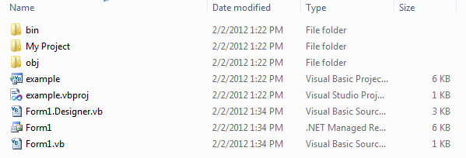
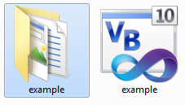
Visual Basic Project Folder
Contains the name of your current project and the many individual components which may be related to the project.
includes a project file (.vbproj) and a solution file (.sln).
A project file contains information specific to a single programming task.
A solution file contains information about one or more projects.
Notes:
A programming block is group of code- like a sub, an IF statement, or a loop.

Slide 8
Solution Explorer Window
Special Note:
If Your Visual Basic Project Only Contains One Project (.vbproj) and One Solution (.sln), Opening the Project is the Same as Opening the Solution .
For a Multi-Project Solution, Open the Solution File Only.
Notes:
The watch window allows the coder to track the value of variables as the program is being executed. This is useful way to catch logic errors that might otherwise be missed.

Slide 9
Visual Studio Tools
The Visual Studio IDE Appears.
The Main Tools Visible Are:
Designer Window
Solution Explorer Window
Properties Window, and
The Toolbox

Slide 10
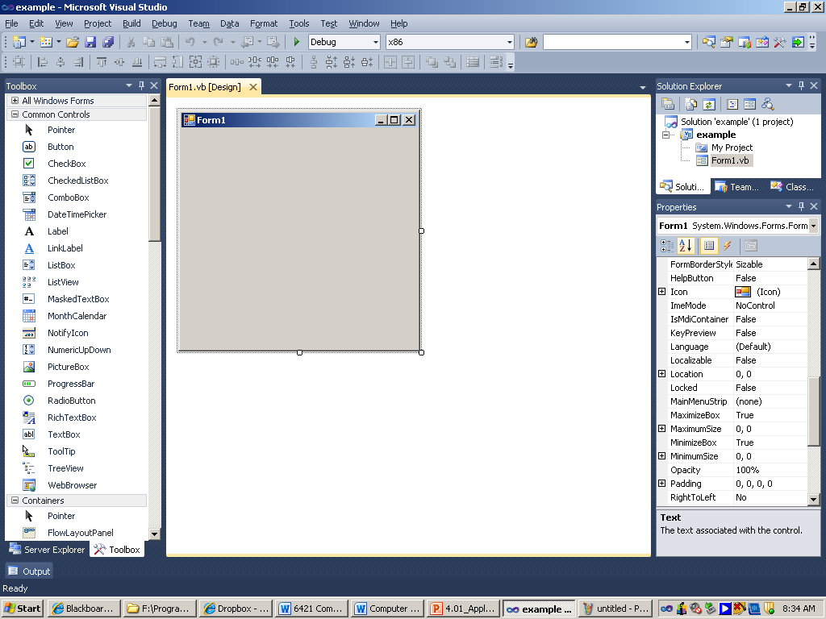
Solution Explorer Window
Toolbox
Properties
Window
Designer Window

Slide 11
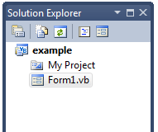
The Solution Explorer Window
The Solution Explorer window displays a list of the projects in the solution and the items contained in the project.
View Code
Refresh
View Designer
Properties
My Project files
Show All Files
Source Code File

Slide 12
Designer Window
Designer Window
Contains a Form.
To Change the size of the Form
Click and Drag the Sizing Handles on the Corner of the Form or
Change the Size Properties (Measured in Pixels) on the Properties Window.

Slide 13
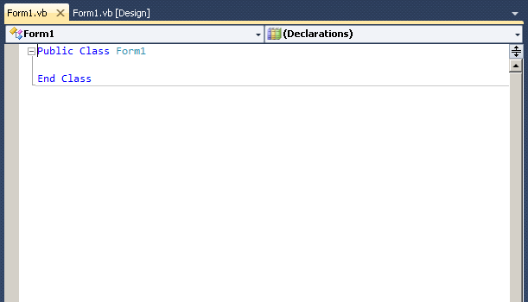
The Editor Window
This White Window Will Contain Your Program Code.
Class Name List
Contains all control objects on form
Method Name List
Contains all methods for the chosen object

Slide 14
Properties Window
The Properties Window is Utilized to Change the Characteristics of Your Form During Design Time.
Some of the Object Properties You Can Change include:
Name
Font
AutoSize
BackColor
ForeColor
Enabled
Size
Text

Slide 15
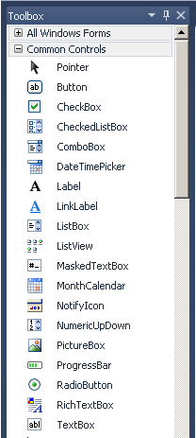

The Toolbox
The Toolbox Contains the Controls for Designing a Form.
The Toolbox Tab Appears on the Left of the IDE.
To Make the Toolbox Visible,
Click Toolbox Tab and Click the Virtual Push Pin.
View Menu > Toolbox
Click the Toolbox button.
Notes:
Try..Catch can be used for other things too, but this is a main use. An exception is an error the program cannot handle on its own.

Slide 16
The Toolbox Controls
Controls Are Objects Which Can Be Placed on Your Form Using Either the Double-Click or Click and Drag Method.
Examples of Some Toolbox Controls:
Buttons
Labels
Option Buttons
Check Boxes
List Boxes, etc.

Slide 17
Common Controls
Button
clicked by the user to perform an action or group of actions.
TextBox
used to gather input from a user or to display text back to the user.
Label
used to display information to the user either to identify another object, provide instructions, or display output.
ListBox
used to display a list of items for a user to select. Multiple items can be selected.

Slide 18
Common Controls
ComboBox
A drop down menu that also allows a user to type in an entry or select an option.
Combines a ListBox and a TextBox
CheckBox
Usually found in a group box
Allows users to provide multiple inputs to answer a question
RadioButton
Used with group boxes
Allows user to make only one choice from the options in the group.
PictureBox
used to display a picture or image to the user.

Slide 19
Adding a Control
To add an object to a form
Click a control in the Toolbox and then click the form
The pointer shape displays an icon similar to the selected control.
There are snap-to lines that you can use for alignment.
Moving an object
Drag a control object to move it.
You can select a group to move together

Slide 20
Designing a Form
Remember that a balanced and pleasing design to a form is important.
Try to make your form appear as professional as possible.
When applying background color to your form, consider the user and/or culture.

